Slide 1
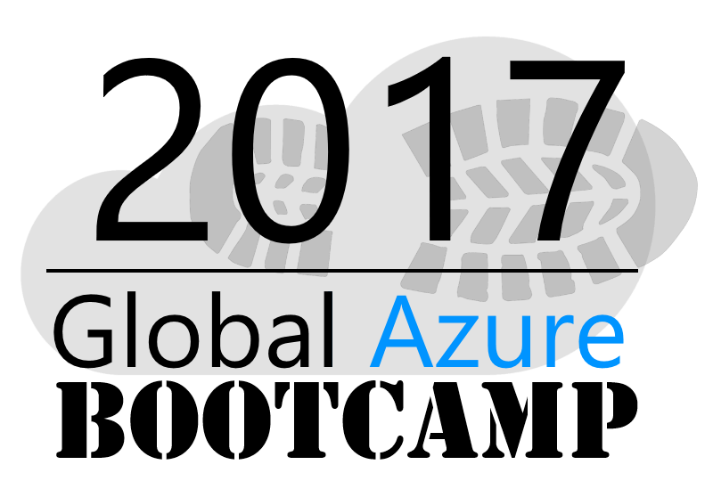
Welcome to the
OTTAWA

Slide 2

Welcome!

Slide 3
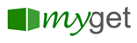





2017 Global Sponsors
Make sure to ask the organizers for the “Stuff We All Get” information!

Slide 4



Stuff We All Get
Sponsor | Offering
Cloudmonix https://cloudmonix.com/ | Cloudmonix offers 1 full month of unlimited monitoring under the Ultimate plan.
SentryOne http://www.sentryone.com/ | SQL Sentry offers an extended evaluation for every attendee.
ServiceBus360 http://www.servicebus360.com | Servicebus360 offers an extended license until September 30 for all attendees, and this for 3 namespaces, 3 alarms per namespace, 3 resources per namespace to monitor and 2 users.
OpsGility http://www.Opsgility.com | Opsgility offers a 30 day subscription free trial for all attendees.
Make sure to ask the organizers for the “Stuff We All Get” information!

Slide 5

Raffle Prizes
1 Winner: One license choosen from ReSharper, dotTrace Memory, dotTrace Performance, dotCover, dotPeek, PhpStorm, PyCharm, IntelliJ IDEA, AppCode, WebStorm, RubyMine
You’ll receive a voucher with a code from the organizers.
1 Winner: a 1 year license of DBSentry (formerly Performance Advisor for Azure SQL Database) for raffle per location.
Give your Full name and email to the Organizers
MyGet is offering a free Starter subscription for 1 year for 1 attendee per location.
Give your Full name and email to the Organizers
They offer 3 12-month subscriptions per GAB Location.
Give your Full name, email phone and company to the Organizers

Slide 6
Welcome Let’s get acquainted

Slide 7
Agenda
9:00-9:15 Intro + Azure Portal
9:15-10:00 Web Apps
10:00-10:30 Azure Storage
10:30-10:45 Break
10:45-12:00 Azure Functions
12:00-12:30 Lunch
12:30-1:15 Microsoft Cognitive Services
1:15-2:00 DocumentDB
2:00-2:15 Break
2:15-3:00 Monitoring with App Insights
3:00-4:00 DevOps

Slide 8
Agenda
9:00-9:15 Intro + Azure portal Welcome and introduction to the Azure portal
François Boucher
Eric Leonard

Slide 9
Agenda
9:15-10:00 Web Apps Creating and deploying a Web site with Visual Studio. Overview of settings and options in Visual Studio and in the Azure portal.
Name

Slide 10
Agenda
10:00-10:30 Azure Storage Exploring Azure Storage and saving a message in the Storage Queue. Using the Visual Studio tooling.
Name

Slide 11
Agenda
10:30-10:45 BREAK
10:45-12:00 Azure Functions Serverless computing is popular these days and you'll see how to create an Azure function whose trigger will be adding the message to a Storage Queue.
Name

Slide 12
Agenda
12:00-12:30 Lunch 12:30-1:15 Microsoft Cognitive Services You will see how to analyze a text using the Sentiment Analysis API in order to extract its feeling (positive or negative) as well as the language used.
Name
Notes:
pizza all dressed et végé, gracieuseté de Microsoft

Slide 13
Agenda
1:15-2:00 DocumentDB You know relational databases like SQL Server but do you know the ones that are NoSQL? You will see how to save the data collected in the DocumentDB database.
Name

Slide 14
Agenda
2:00-2:15 BREAK
2:15-3:00 Monitoring with App Insights Once deployed, it is important to properly monitor our application. Application Insights is a service for instrumenting Web applications to monitor performance and usage.
Name

Slide 15
Agenda
3:00-4:00 DevOps What is DevOps? You will see how to script your environment in order to recreate it easily via script and ARM template.
Name

Slide 16
Step 0 Intro + Azure Portal
Frank Boucher / Eric Leonard

Slide 17
Goal
Getting to know Azure and the Portal

Slide 18
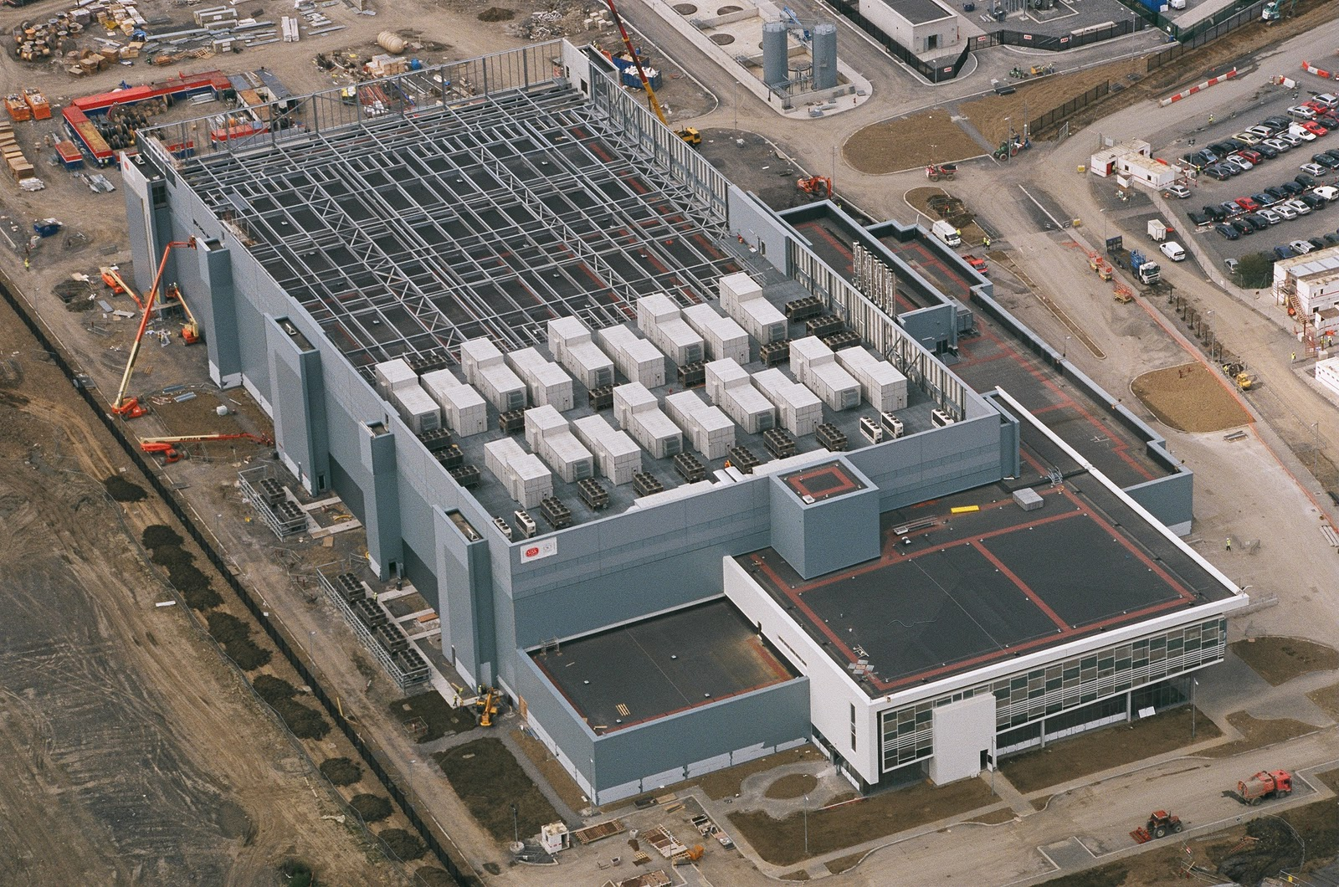
Notes:
This is what we think of when we hear the word “Datacenter”

Slide 19
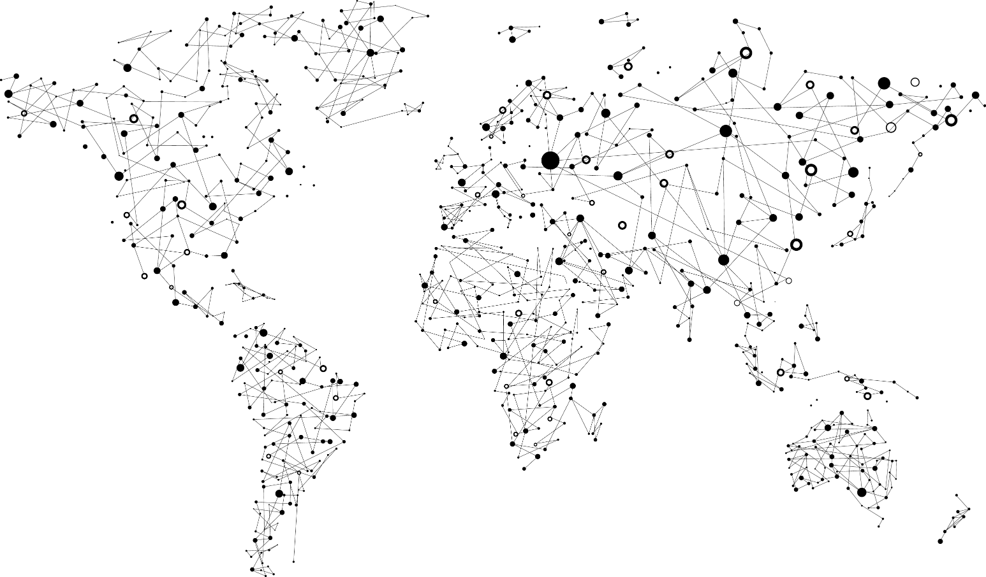
Achieve global scale, in local regions
Trust
38
Azure regions
RECENTLY LAUNCHED:
US Regions: West US 2 and West Central
Germany – Launched in Sep 2016
United Kingdom – Launched in Sep 2016
NEWLY ANNOUNCED:
France: France Central and France South
Korea: Korea Central and Korea South
DoD East and Central
Notes:
At the core of Azure is its global infrastructure that spans 38 regions worldwide. We have the largest footprint of any cloud provider.
https://azure.microsoft.com/en-us/regions/
https://azure.microsoft.com/en-us/regions/services/

Slide 20
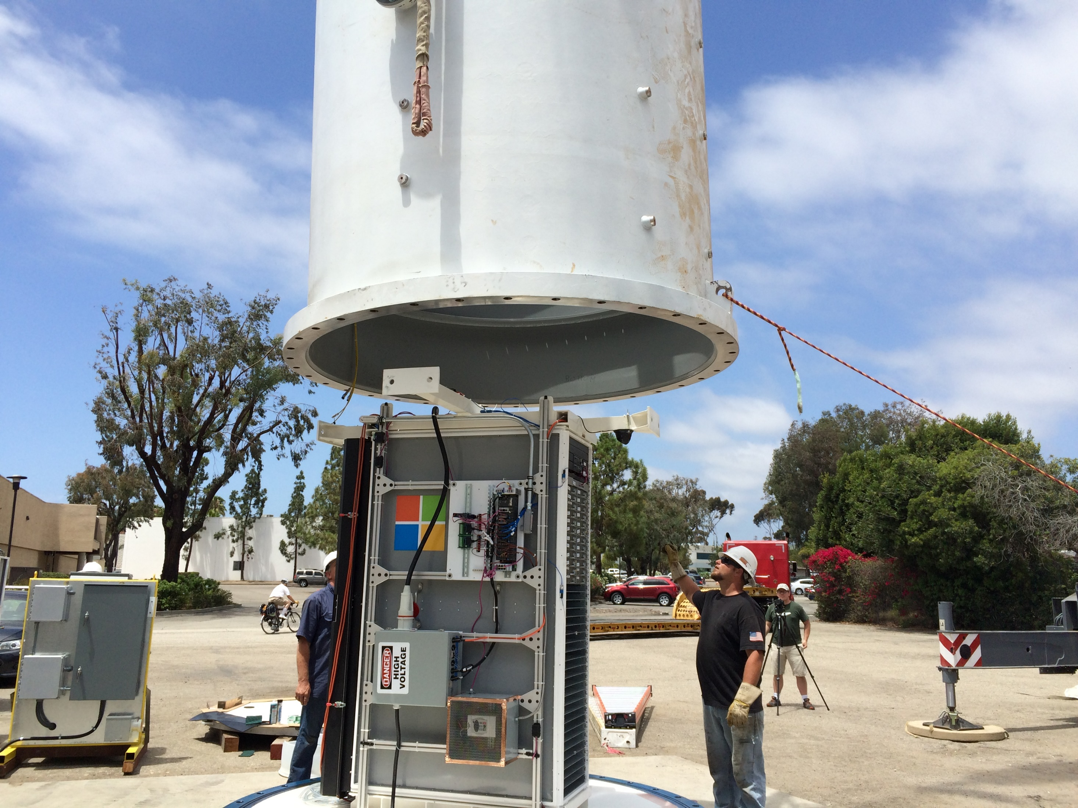
Notes:
My kids will probably hold a very different images of what a data center is. Microsoft Research is actively working on new approaches to bring resources online with more agility and proximity.

Slide 21
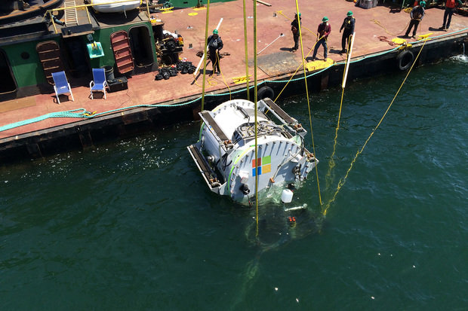
Notes:
Con’t

Slide 22
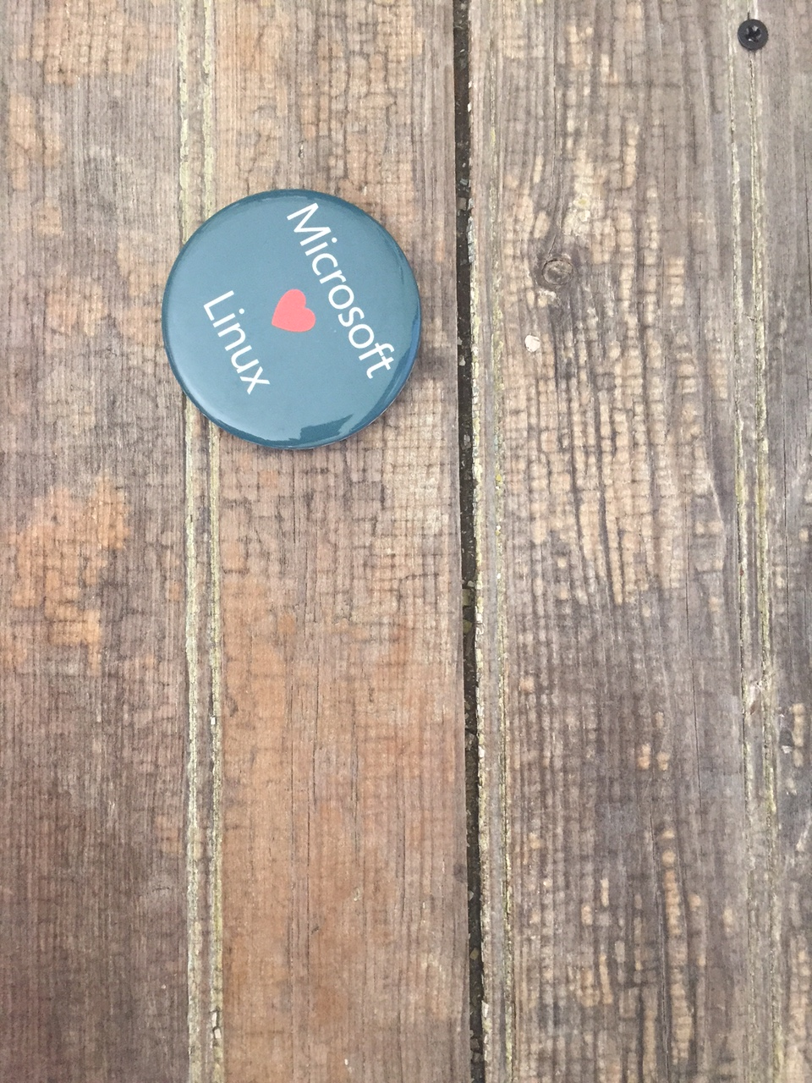
Notes:
Azure isn’t about Windows, its about enabling you to achieve more. Microsoft is undergoing a tremendous transformation and Linux/ Open Source Software is part of it. In a second we will dive in and I want you to remember that Microsoft is now the number contributor to OSS on GitHub and that some of the offered services are built and operated on Linux.
One of these services is the Azure SDN (Software Defined Network)
http://www.datacenterdynamics.com/content-tracks/servers-storage/microsoft-runs-azure-networking-on-linux/94837.fullarticle
Azure cloud uses Linux to handle data center networking - in a specialized software component developed by Microsoft to run conectivity within its cloud operating system, along lines set out by the Open Compute Project.

Slide 23
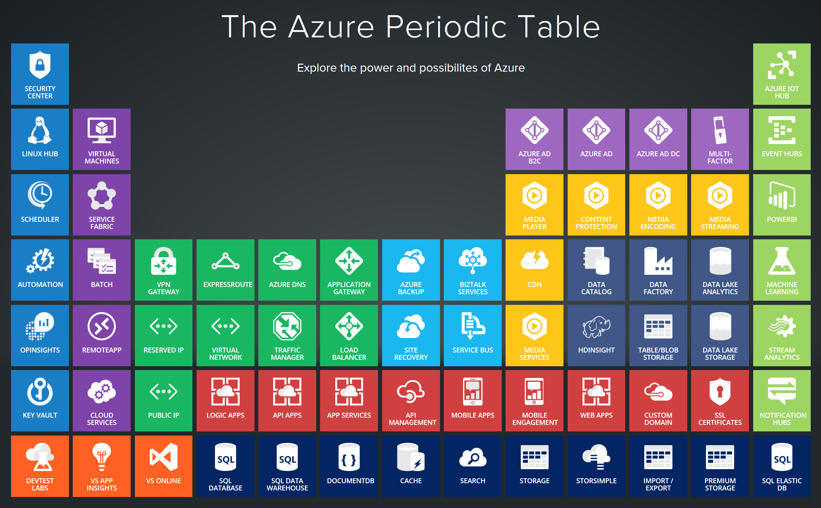
Notes:
Azure services support a multitude of scenarios from Infrastructure to platform services and extends your existing environments through various interconnectivity options. In today’s world, the level of sophistication required to innovate and compete requires us to be agile and adjust to a rapidly changing landscape. The cloud-only approach doesn’t work well for every scenario. Think about IoT and business critical workloads that drive delay sensitive manufacturing processes. Success comes from taking a hybrid approach and leveraging the cloud where it makes sense.

Slide 24
http://portal.azure.com
Notes:
Walk through the different sections, support tickets, azure market place, resource groups….

Slide 25
References:
Get started with Azure
Microsoft Azure Blog
Azure Updates
Cloud Platform roadmap
Azure Code Samples
Azure Quickstart Templates
AzureCAT Guidance
Cloud Design Patterns

